Slide 1
Generative Molecular Design (and other useful information, maybe…) Joe Ivanic Advanced Biomedical Computational Science

Slide 2
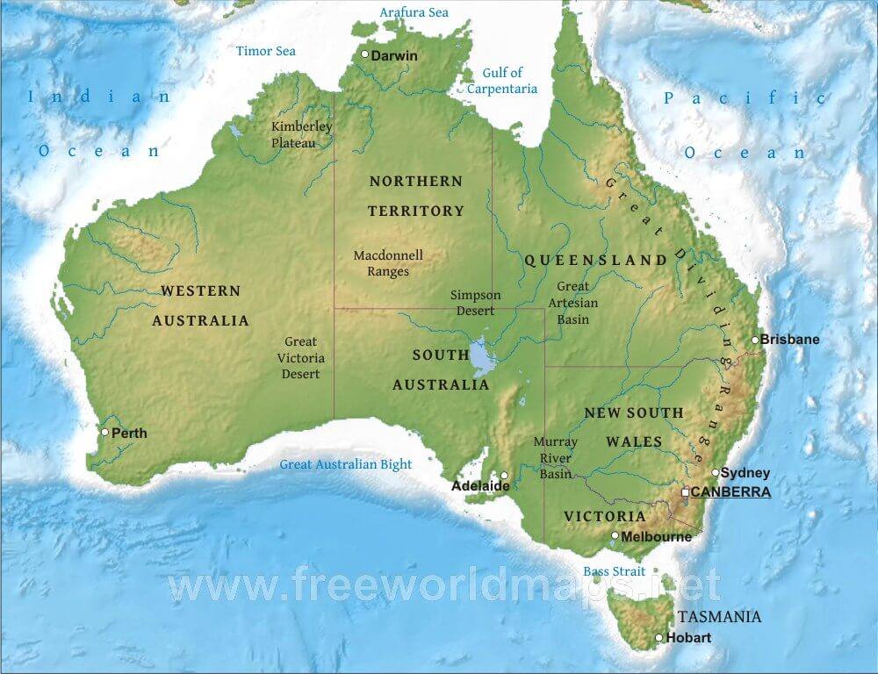
Joe Ivanic: Life and Career Summary
Nhulunbuy, NT, Australia
Ames Laboratory (DoE)
Iowa, USA
University of Melbourne
Undergrad (Science)
Ph.D. in
Quantum Chemistry
(1995)

Slide 3
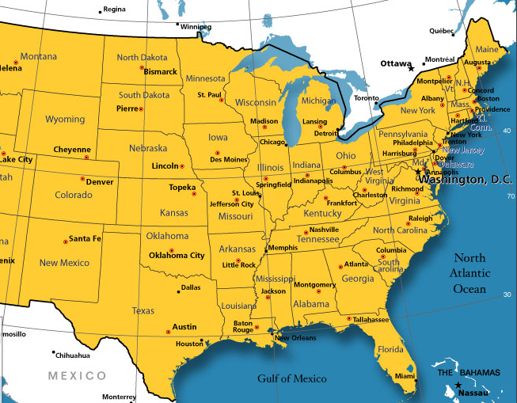
Joe Ivanic: Life and Career Summary
Postdoc with Klaus Ruedenberg: Schrodinger Medal 2018, 101 years old
DoE Research Institute, Iowa (Quantum Chemistry: 1995 - 2001)
NCI-Frederick / ABCC (2001-05)
SAIC-Frederick
Quantum Chemistry
DoD (2005-09)
Bioinformatics/Network Science
FNLCR / ABCS (2009)
Leidos Biomed
Quantum Chemistry

Slide 4
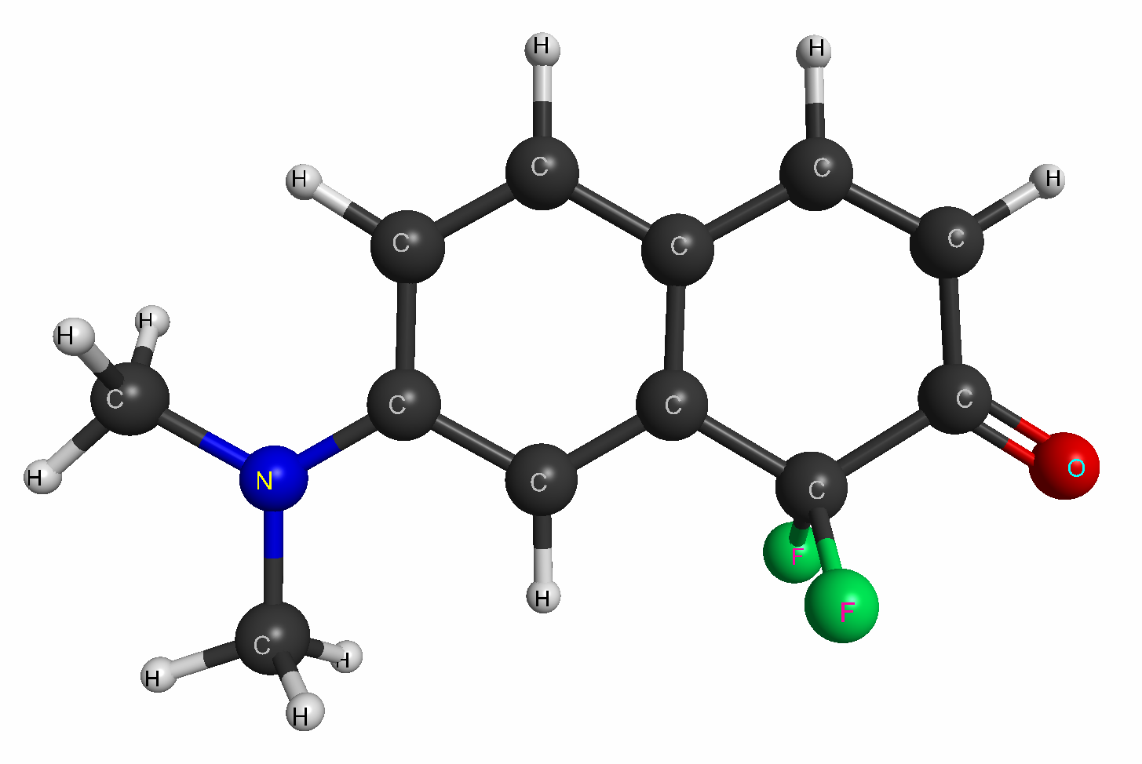
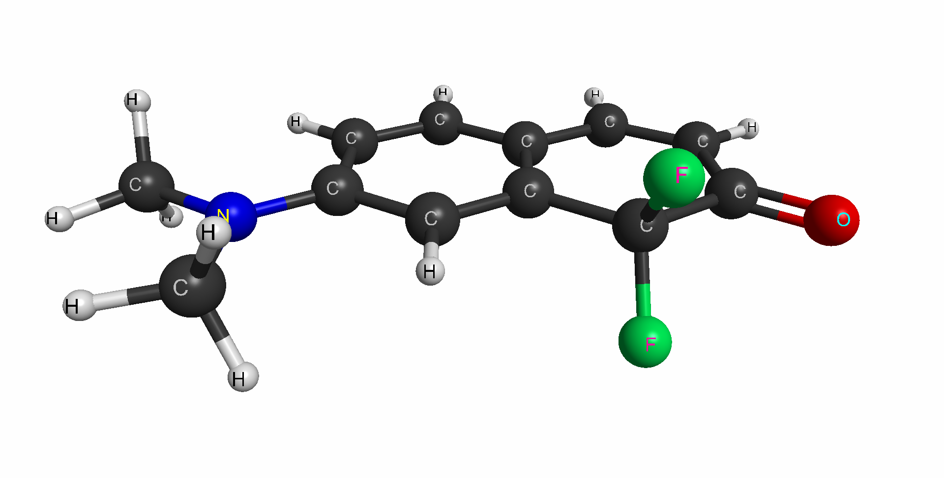
Introduction to Molecules
This is a molecule
Top view
Front view

Slide 5
Introduction to Molecules
This is a molecule
Note:
It has a 3D shape (most can have more than 1)
Top view
Front view

Slide 6
Introduction to Molecules
This is a molecule
Note:
It has a 3D shape (most can have more than 1)
It contains functional groups/units
These are (mostly) responsible for a molecule’s property
Aromatic ring
Amino
Carbonyl
Difluoromethylene

Slide 7
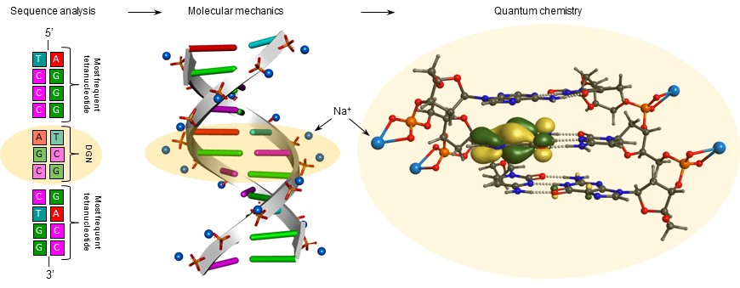
Introduction to Molecules: Representations
Some molecules are big, e.g., DNA
Electron orbital (there are many)
Sequence
Ribbon image
Atoms/bonds in middle trinucleotide

Slide 8
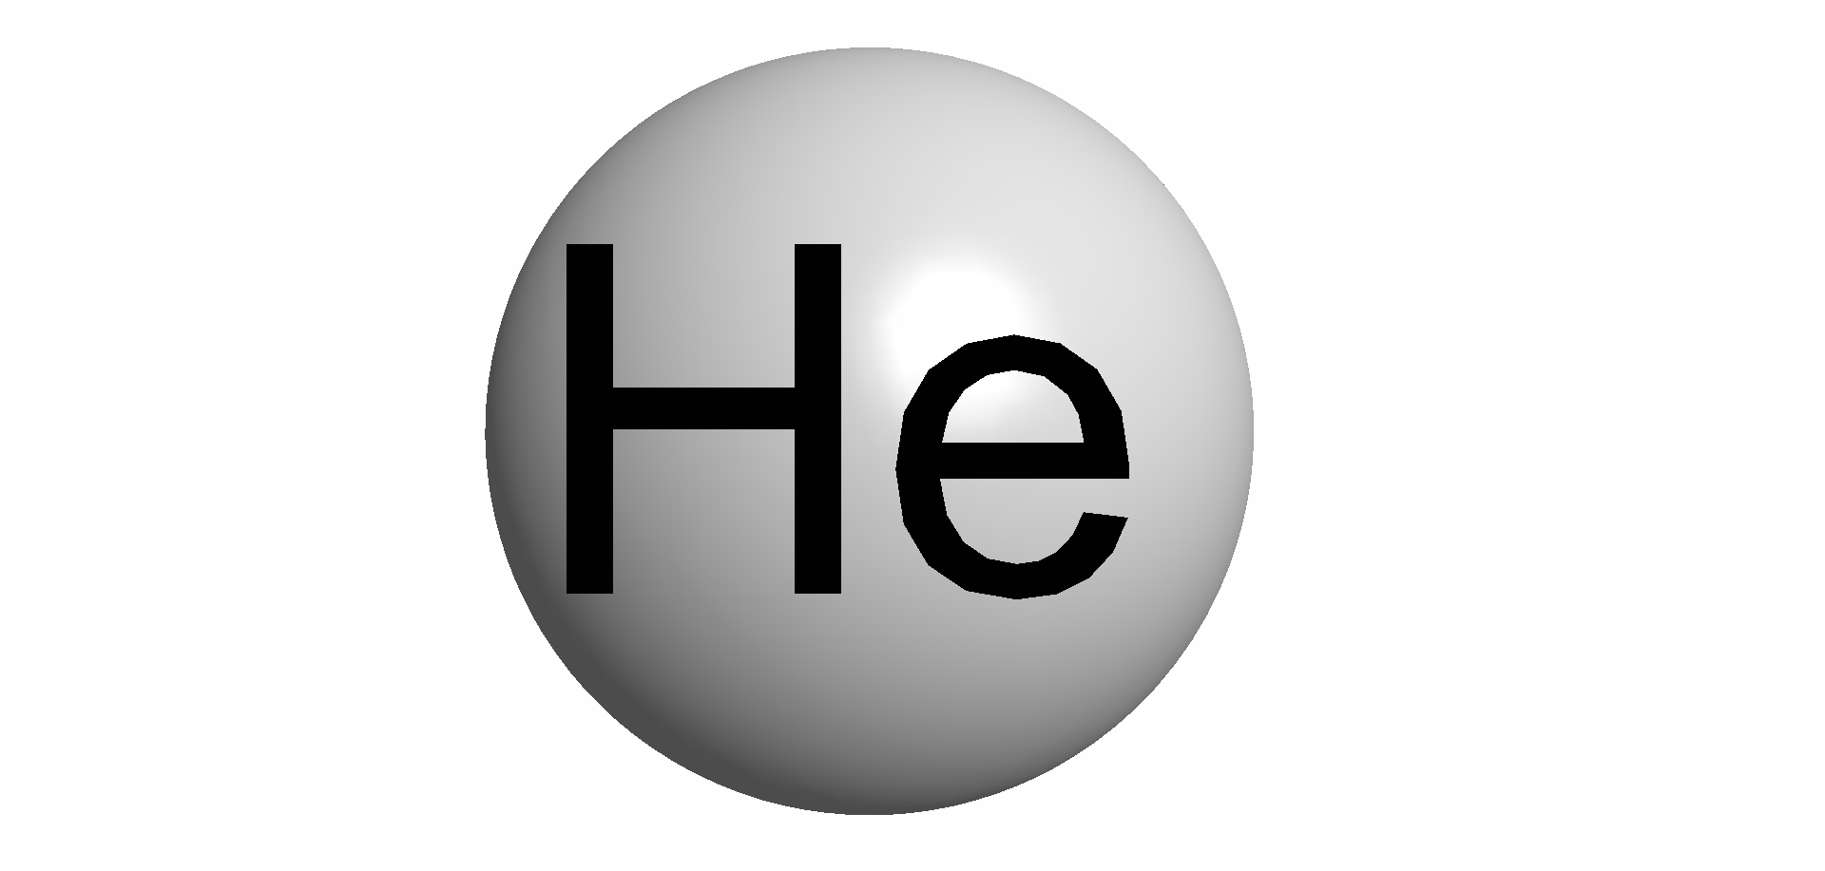
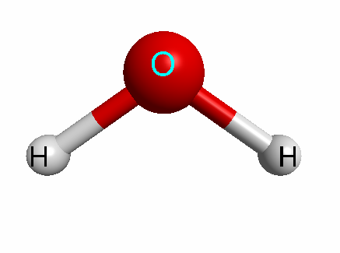
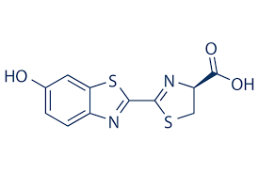
Introduction to Molecules: Representations
Some molecules are small(ish)
Helium: doesn’t react with anything (on this planet)
Water (H₂O): why is it bent?
D-Luciferin: How does it emit light? (fireflies use it to glow)

Slide 9

Machine Learning for Molecule Property Modeling
Turn molecules into ‘numbers’
‘Numbers’ should represent/describe molecule features
Several ways to turn molecules into ‘numbers’
ECFP, Mordred, MOE, graph-based methods…
Train Model to use ‘numbers’ to predict property
Use Model to predict property of new molecules
New Molecules
Molecules
Property
Molecules’
Property
Model
12.4
a₁,a₂, …
12.4
76.4
b₁,b₂, …
76.4
e₁,e₂, …
25.2
c₁,c₂, …
25.2
100.3
d₁,d₂, …
100.3
150.7

Slide 10
Machine Learning for Molecule Property Modeling
Turn molecules into ‘numbers’
‘Numbers’ should represent/describe molecule features
Several ways to turn molecules into ‘numbers’
ECFP, Mordred, MOE, graph-based methods…
Train Model to use ‘numbers’ to predict property
Use Model to predict property of new molecules
AMPL
New Molecules
Molecules
Property
Molecules’
Property
Model
12.4
a₁,a₂, …
12.4
76.4
b₁,b₂, …
76.4
e₁,e₂, …
25.2
c₁,c₂, …
25.2
100.3
d₁,d₂, …
100.3
150.7

Slide 11
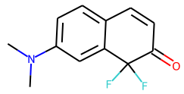
Representations of Molecules
Ways to represent molecules (there’s more, e.g., InChI)
Actual molecule
CN(C)c1ccc2c(c1)C(F)(F)C(=O)C=C2
SMILES string
C C N C C C C C C C C C C O F F
C 1
C 1
N 1 1 1
C 1 2 1
C 2 1
C 1 2
C 2 1 1
C 1 1 1
C 1 1
C 1 2
C 2 1
C 1 1 2
C 1 1 1 1
O 2
F 1
F 1
3D (atom coordinates)
6
10
5
7
11
1
4
12
8
13
3
14
9
2
16
15
2D (atom coordinates)
Graph (in terms of atoms/bonds)

Slide 12
Generative Molecular Design (GMD)
Basic goal:
Turn this into...
Vector...
So we can do math on molecules
a₁
a₂
.
.
.
a_{i}
.
.
.
f(A) = Property (emission λ )
* Use math to find B
f(B) = Better property (longer λ)
A =
A
Emission λ = 417 nm
Goal is to design similar molecule that emits in near-IR region for in vivo research * But using AI
B
Emission λ = 740 nm (Near-Infrared)
Chem. Sci. (2020)

Slide 13
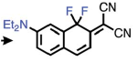
Generative Molecular Design (GMD): Why?
If we have list of molecules and their property, can we use machine learning to find new molecules having even better properties?
Machine Learning
150
hundreds
or
thousands more…

Slide 14
Generative Molecular Design (GMD): Why?
If we have list of molecules and their property, can we use machine learning to find new molecules having even better properties?
Machine Learning
150
GMD is different from ‘AMPL’ in that we’d
like GMD to predict or design the above
molecule via machine learning
AMPL might give you a good prediction of property for the above molecule, but you already have to know it
hundreds
or
thousands more…

Slide 15
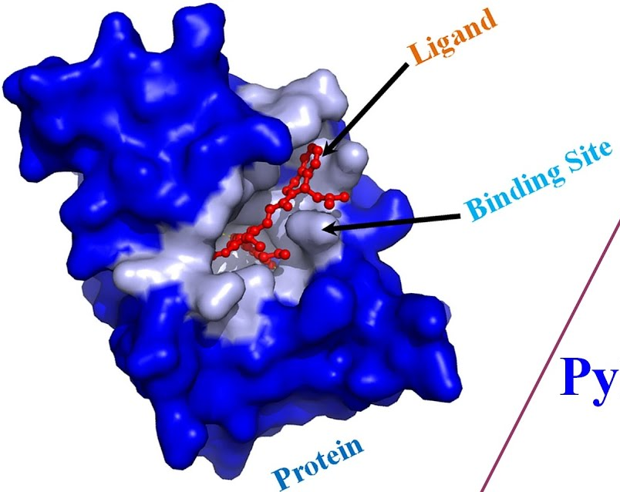
Generative Molecular Design (GMD): Why?
If we have list of molecules and their property, can we use machine learning to find new molecules having even better properties?
So far primarily being used for drug design – find molecules that bind/inhibit a drug/protein/gene target better
Molecules
A
B
C
D
E
…
Binding Affinities (IC₅₀)
V
W
X
Y
Z
…
XYZ
Big number
Machine Learning

Slide 16

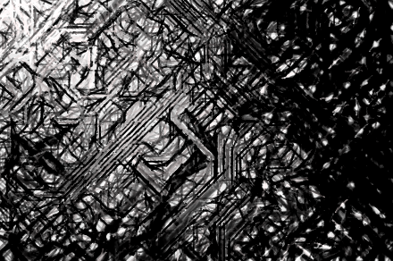
Generative Molecular Design (GMD)
GMD Step 1 – Implement Autoencoder
Desire Original and Decoded molecules to be as similar as possible: ideal = 100 %
Original molecule list
(known properties)
Latent vectors
Decoded molecules
Encoder
Decoder

Slide 17
Generative Molecular Design (GMD)
GMD Step 1 – Implement Autoencoder
Desire Original and Decoded molecules to be as similar as possible: ideal = 100 %
Original molecule list
(known properties)
Latent vectors
Decoded molecules
Encoder
Decoder
It’s not immediately obvious, but the challenge is to turn a Molecule into Numbers, but then go from Numbers back to the original Molecule.
AMPL only goes one way: Molecule → Numbers
GMD is a different challenge: Molecule → Numbers → Molecule

Slide 18
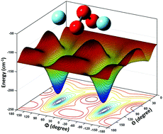
Generative Molecular Design (GMD)
GMD Step 1 – Implement Autoencoder
GMD Step 2 – Implement molecule optimization in latent space
Desire Original and Decoded molecules to be as similar as possible: ideal = 100 %
Original molecule list
(known properties)
Latent vectors
Decoded molecules
Encoder
Decoder
Optimize property in
latent vector space
Better molecules
Decode

Slide 19
Generative Molecular Design (GMD)
GMD Step 1 – Implement Autoencoder: JTVAE
Desire Original and Decoded molecules to be as similar as possible: ideal = 100 %
Original molecule list
(known properties)
Latent vectors
Decoded molecules
Encoder
Decoder
JTVAE

Slide 20
Junction Tree Variational Autoencoder (JTVAE)
CN(C)c1ccc2c(c1)C(F)(F)C(=O)C=C2
6
10
5
7
11
1
4
12
8
13
3
14
9
2
16
15
Graph (in terms of atoms)
C C N C C C C C C C C C C O F F
C 1
C 1
N 1 1 1
C 1 2 1
C 2 1
C 1 2
C 2 1 1
C 1 1 1
C 1 1
C 1 2
C 2 1
C 1 1 2
C 1 1 1 1
O 2
F 1
F 1

Slide 21
Junction Tree Variational Autoencoder (JTVAE)
CN(C)c1ccc2c(c1)C(F)(F)C(=O)C=C2
Junction Tree
Clusters
6
10
5
6
1. Bonds
2. Rings
3. Atoms joined to
≥ 3 bonds/rings
5
7
11
1
4
1
4
12
8
7
8
13
3
3
14
10
9
9
2
2
16
15
Graph (in terms of atoms)
Tree (in terms of clusters)
C C N C C C C C C C C C C O F F
C 1
C 1
N 1 1 1
C 1 2 1
C 2 1
C 1 2
C 2 1 1
C 1 1 1
C 1 1
C 1 2
C 2 1
C 1 1 2
C 1 1 1 1
O 2
F 1
F 1
Vocabulary (clusters)
V₁ = C1–N3
V₂ = C2–N3
V₃ = N3-C4
V₄ = N3
V₅ = C4C5C6C7C8C9
V₆ = C7C10C11C12C13C8
V₇ = C12=O14
V₈ = C13
V₉ = C13-F15
V₁₀ = C13-F16
1 2 3 4 5 6 7 8 9 10
1 1 1 ∞
2 1 1 ∞
3 1 1 ∞ 1
4 ∞ ∞ ∞
5 1 1
6 1 1 ∞ 1 1
7 1
8 ∞ ∞ ∞
9 1 ∞ 1
10 1 ∞ 1

Slide 22
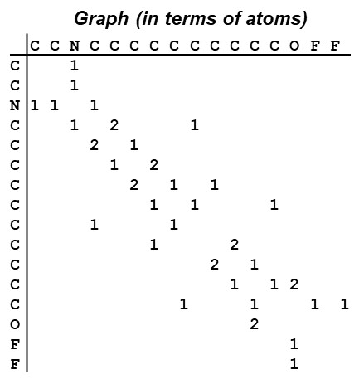
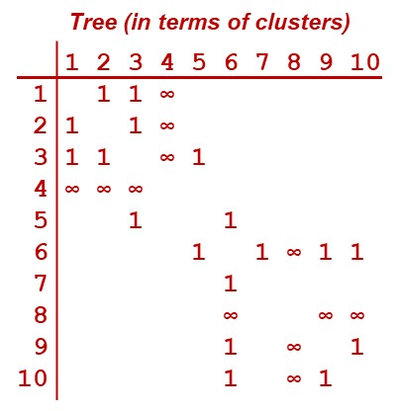
Junction Tree Variational Autoencoder (JTVAE)
Latent Vectors
G
Weights
z_{G}
Message Passing NN
+ other data
Encoding
* complex! *
T
Weights
z_{T}
Message Passing NN

Slide 23
Junction Tree Variational Autoencoder (JTVAE)
Latent Vectors
G
Model/parameters trained
by maximizing
<G|G’>
&
<T|T’>
via Deep Learning
G’
Weights
z_{G}
Message Passing NN
+ other data
Parameters
Encoding
* complex! *
Decoding
* complex! *
T
Parameters
Weights
T’
z_{T}
Build T’ one node/cluster
at a time with each
step maximizing
<z_{T} | z_{T’}>
Message Passing NN

Slide 24


Junction Tree Variational Autoencoder (JTVAE)
Generative Molecular Design (GMD)
iteration 0
Train Second Model that tries to correlate Latent Vectors
Properties
Encode
Decode
c3n2)c1
CC#N
C(O)F
Molecule List
(known properties)
OCl
“Better” latent
vectors
New Molecules
Check out
Optimization in
latent space using
Second Model

Slide 25
Junction Tree Variational Autoencoder (JTVAE)
Generative Molecular Design (GMD)
iteration 0
Train Second Model that tries to correlate Latent Vectors
Properties
Encode
Decode
c3n2)c1
CC#N
C(O)F
Molecule List
(known properties)
OCl
“Better” latent
vectors
New Molecules
Check out
Optimization in
latent space using
Second Model
iteration > 0
Can we obtain accurate properties for New Molecules?
Yes, add New Molecules + New Properties → Molecule List
Retrain Second Model & Optimize in latent space
× No, think carefully about how to do further iterations…

Slide 26
Junction Tree Variational Autoencoder (JTVAE)
Questions? Any and All are Welcome ☺
iteration 0
Train Second Model that tries to correlate Latent Vectors
Properties
Encode
Decode
c3n2)c1
CC#N
C(O)F
Molecule List
(known properties)
OCl
“Better” latent
vectors
New Molecules
Check out
Optimization in
latent space using
Second Model
iteration > 0
Can we obtain accurate properties for New Molecules?
Yes, add New Molecules + New Properties → Molecule List
Retrain Second Model & Optimize in latent space
× No, think carefully about how to do further iterations…

Slide 27
Quantum Chemistry for Health Research (and other useful information, maybe…) Joe Ivanic Advanced Biomedical Computational Science

Slide 28
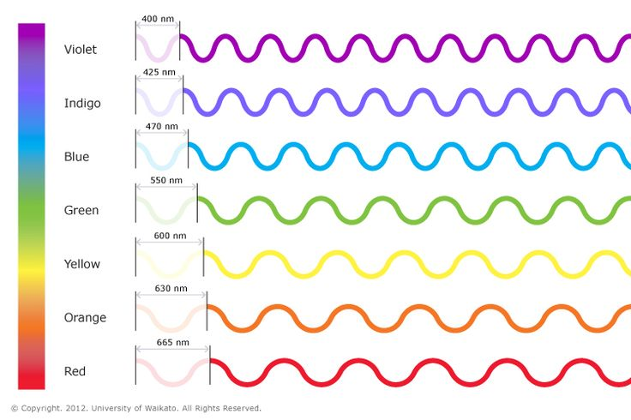
What is Quantum Chemistry?
Discovered that light has wave character

Slide 29
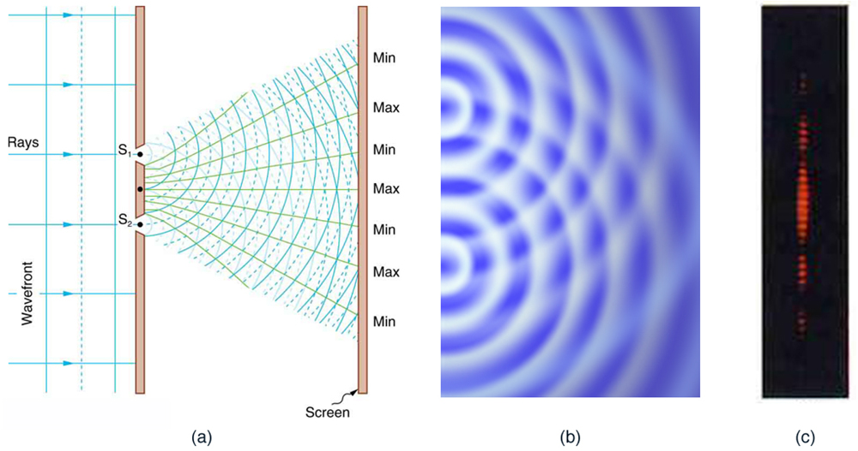
What is Quantum Chemistry?
Discovered that light has wave character
Wave character leads to “interference”
Water waves

Slide 30

What is Quantum Chemistry?
Discovered that light has wave character
Wave character leads to “interference”
Young’s double slit experiment demonstrates “interference” for light
Water waves
Light waves

Slide 31
What is Quantum Chemistry?
Discovered that light has wave character
Wave character leads to “interference”
Young’s double slit experiment demonstrates “interference” for light
Electrons?
−

Slide 32
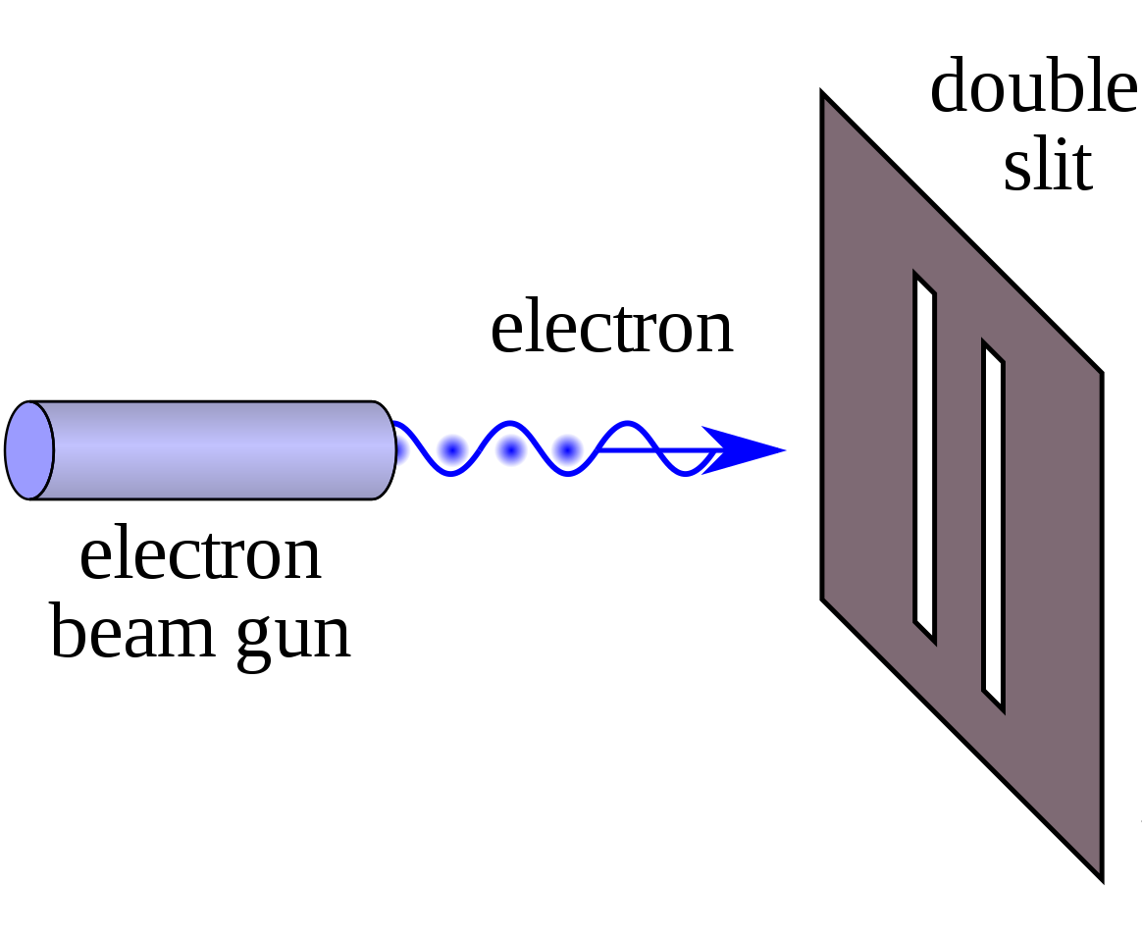
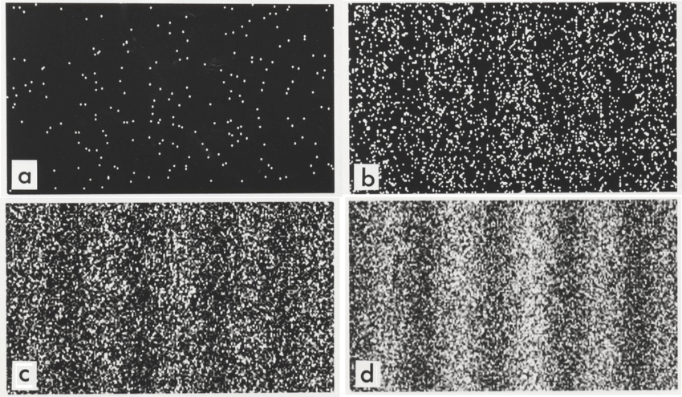
What is Quantum Chemistry?
Discovered that light has wave character
Wave character leads to “interference”
Young’s double slit experiment demonstrates “interference” for light
Electrons fired one at a time through double slit
Electrons?
Electrons have wave
character !!!
Diffraction pattern appears over time

Slide 33
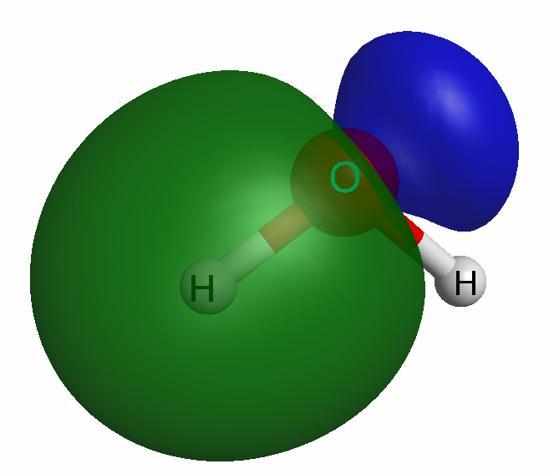
What is Quantum Chemistry?
Atoms have a very heavy positive nucleus (relative to electrons)
Model atoms as containing:
A central positive point charge
Light, fluffy, cloud-like electrons = wavefunction
Model molecules as containing:
Multiple positive point charges
Multiple cloud-like electrons = wavefunction
Helium
Two protons in nucleus (positive)
Two electrons (negative)
Water
+8 (O) and two +1 (H) positive nuclei
10 electrons (negative)

Slide 34
What is Quantum Chemistry?
Can only solve Schrödingers equation exactly for 1 electron
Two electron waves repel each other – need to keep them apart
Modeling multi-electron systems extremely difficult!
Over the last ~90 years very complex methods have been developed
At ABCS we have developed very high-level methods also
Helium
- Two protons in nucleus (positive)
- Two electrons (negative)
−
Repulsion
2+
- Exact energy E = 2.90372…
- Approximate E = 2.90356
(wave function with 4,312 terms)
−

Slide 35
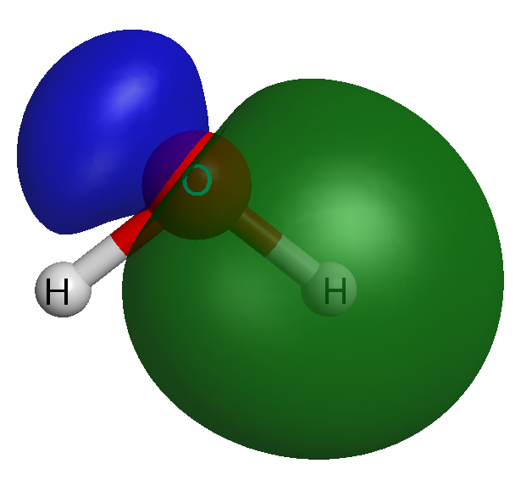
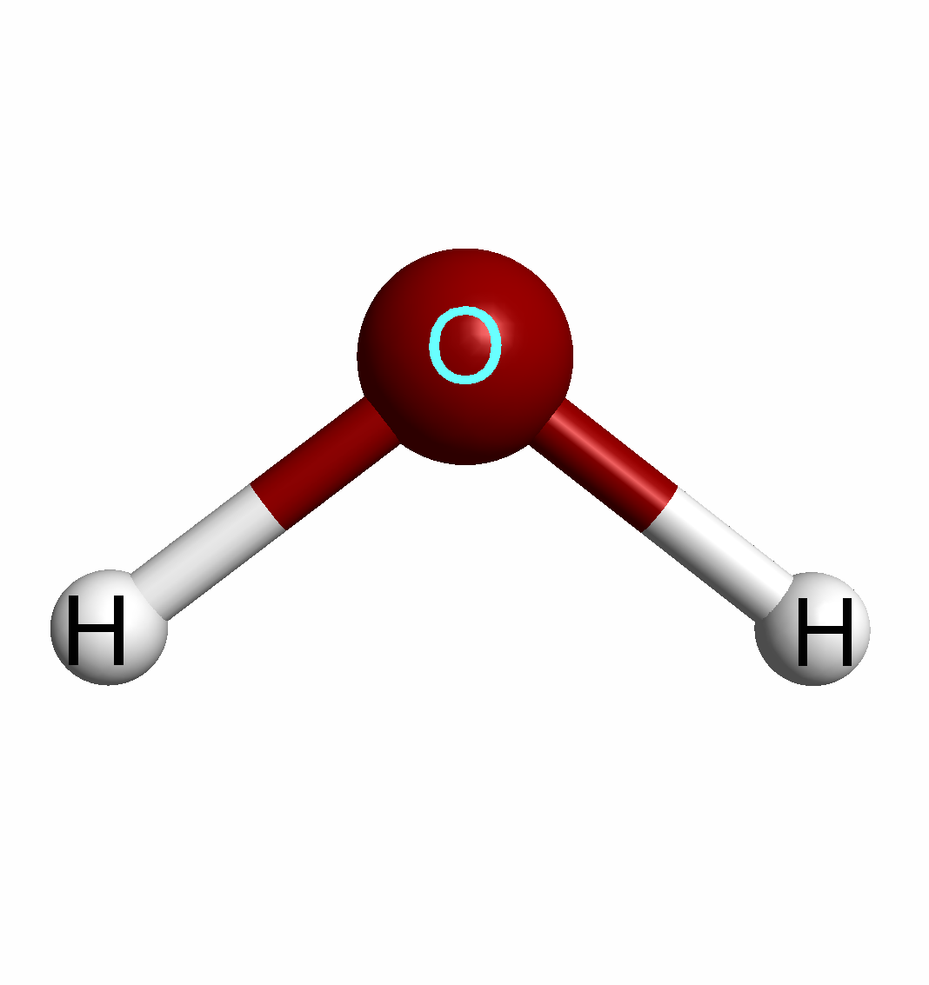
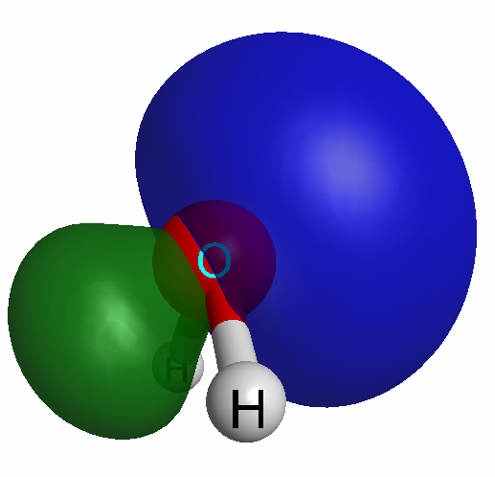
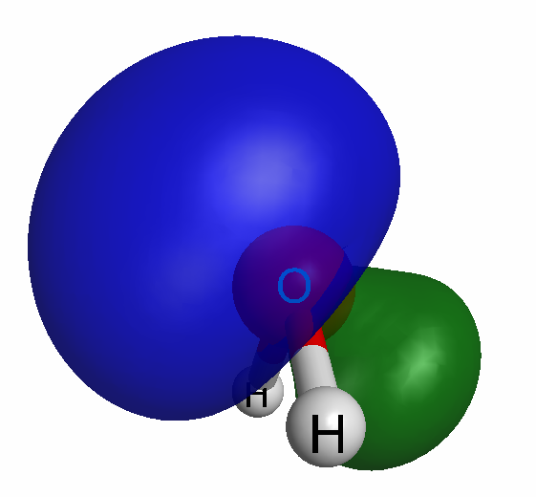
Quantum Chemistry can model ANY chemistry
Use very simple water as example: why is it bent?
If you optimize the electron waves and nuclei positions…
…you obtain 2 O-H bonds and 2 lone pairs
All electron orbitals repel each other so they ‘point’ as far away as possible
Bonds
H₂O
Lone pairs

Slide 36
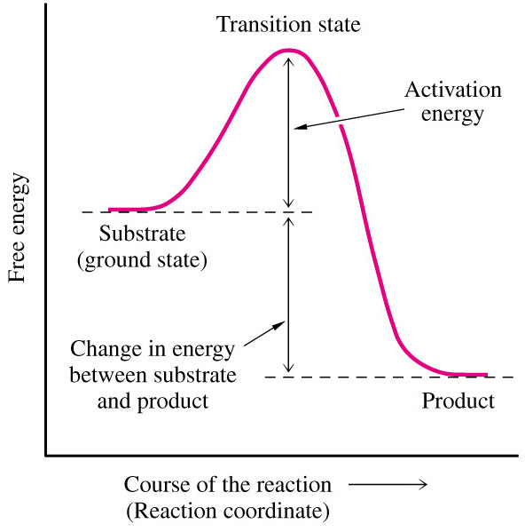
Quantum Chemistry can model ANY chemistry
Can model energetics of reactions
A + B → C + D
Is C + D more stable than A + B? If so, by how much?
How much energy is required to make reaction happen?
A + B
Energy change
for reaction
C + D

Slide 37
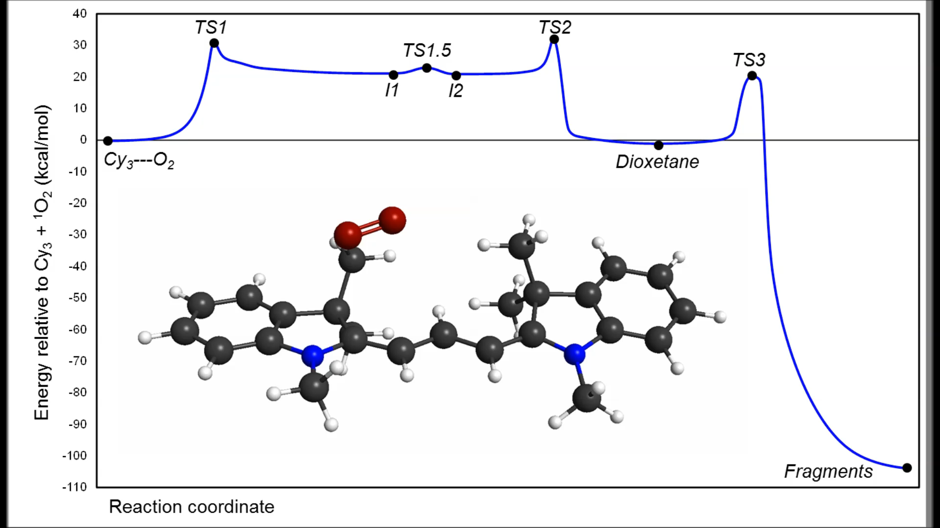
Energetic Profile/Mechanism of Photobleaching: Cy₃
Cy₃ + ¹O₂: MCSCF(14,11) = full O₂ + Cy₃-chain (N → N) π space

Slide 38
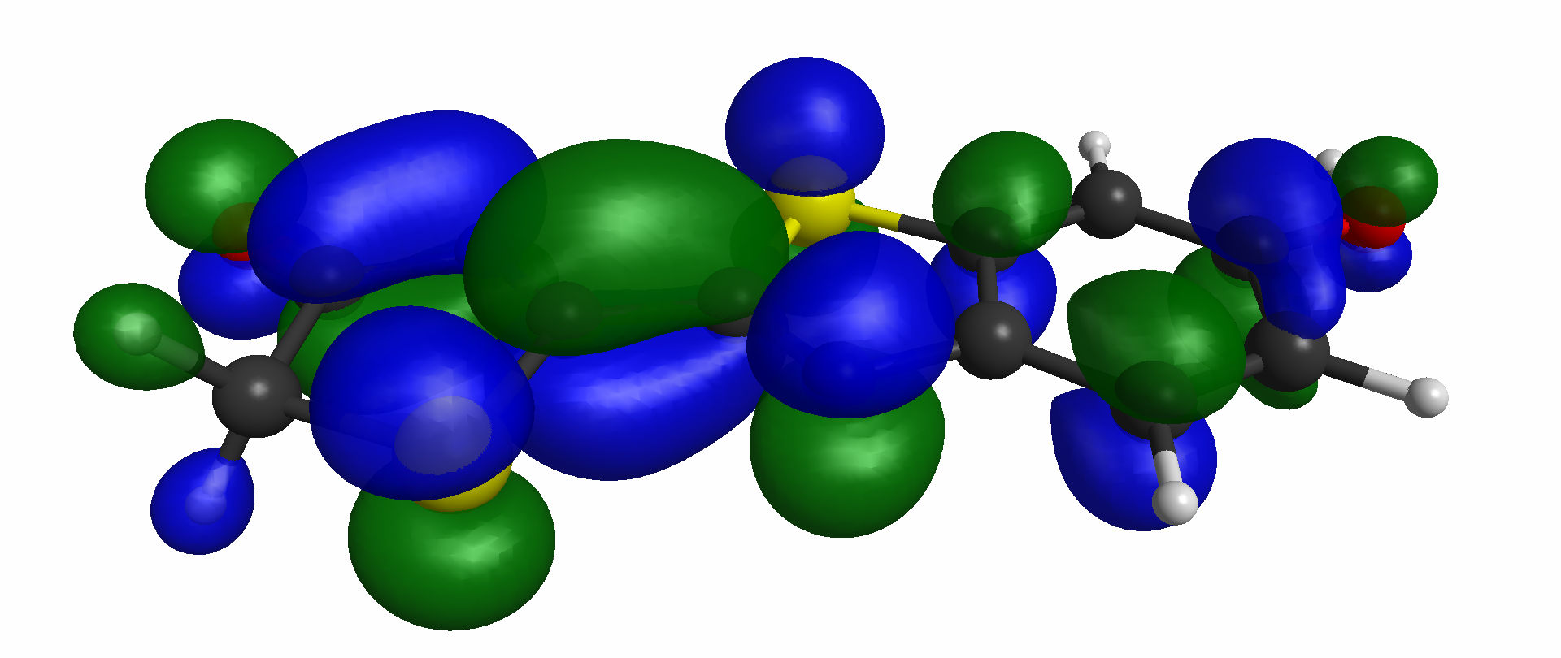

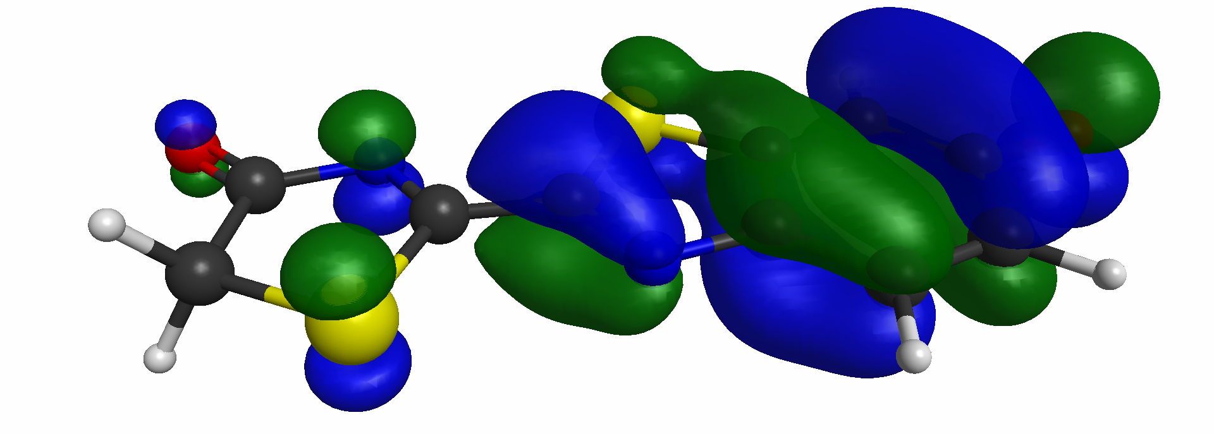
Quantum Chemistry can model ANY chemistry
How do fireflies glow?
Electron drops from higher energy orbital to lower energy one
Energy released as light – can compute ‘color’ of light emitted
e–

Slide 39
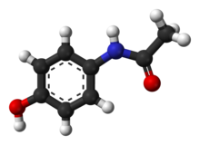
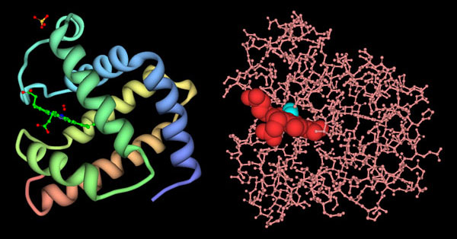
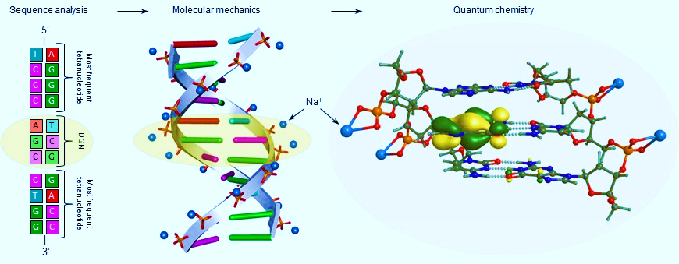
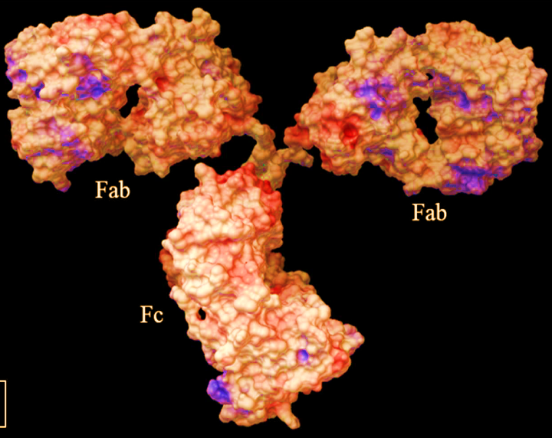
How is Quantum Chemistry Used for Health Research
Most (if not all) biological processes obey laws of physics & chemistry
It’s (nearly) all atoms & molecules
Size of system that can be modeled limited by compute power
Proteins
Drugs (Paracetamol)
Antibodies
DNA/RNA

Slide 40
Infrared Light-activated Drug Delivery Systems
Actual antibody conjugate : CyEt-Pan-Duo – injected in tail
Location imaged via fluorescence
Payload released with near-infrared light
Payload kills tumor cells !!!!
Duocarmycin derivative
- Cell killing machine
Antibody binds to cancer cells

Slide 41
FluoroCoumarins (FC): Long wavelength fluorophores
Quantum predicts new chemistry
New chemistry confirmed experimentally
New near-IR fluorophores for cellular imaging – in vivo potential
Chemical Science 2020

Slide 42
Quantum Biology
Accurately modeled DNA mutation mechanism causing lung cancers
Actual electron that is removed to cause
G → T mutation

Slide 43
Multicolor in vivo imaging of tumors & lymphatic system
Quantum chemistry designed these molecules

Slide 44
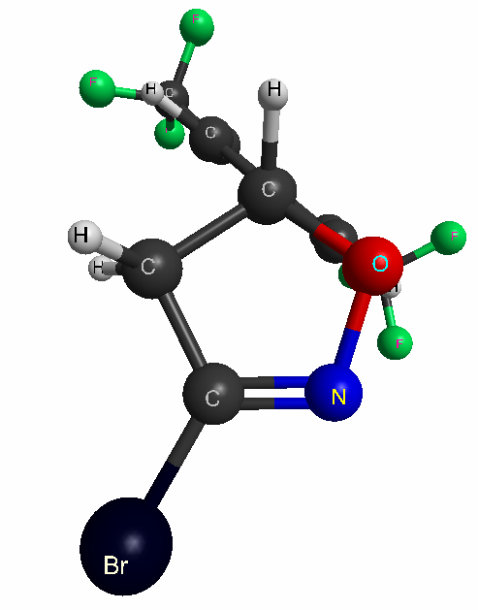
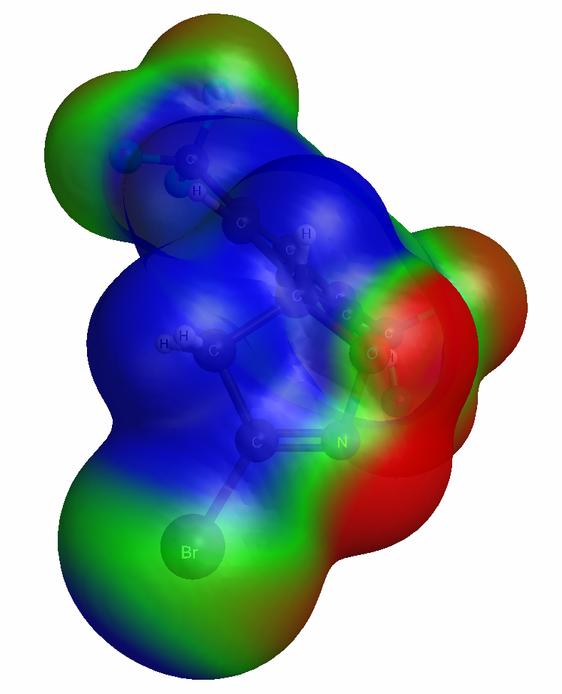
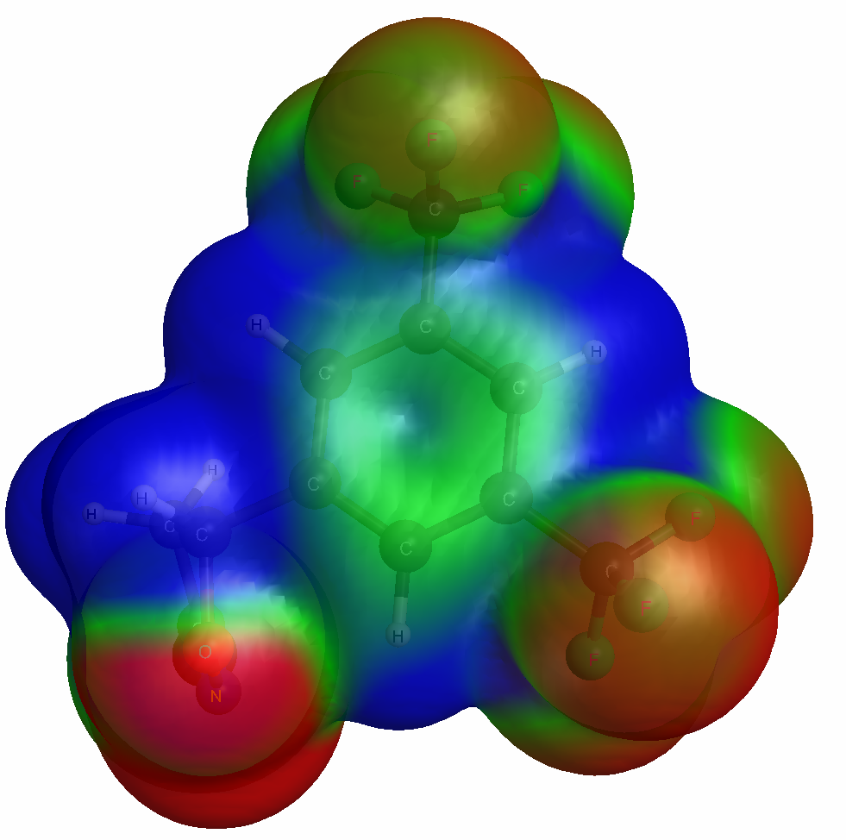
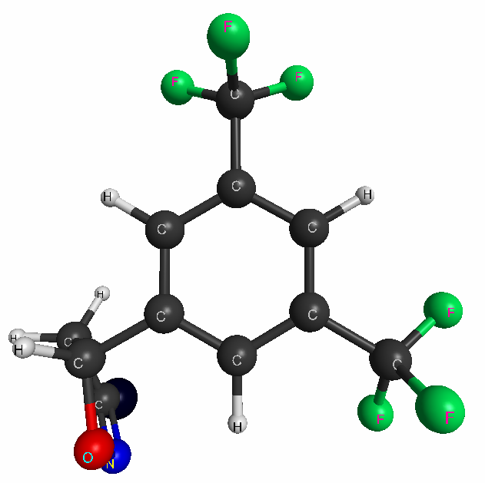
Molecular Electrostatic Potential Maps for Drug Design
Working with NCI to design BDHI-warhead cancer-killing ligands
Electrostatic potential maps show very negative and positive areas
Try to design drugs that have negative/positive areas matching binding site
Front view
(BDHI-warhead)
Side view
(Recognition group)

Slide 45
Computational Science has Significant Roles in Health Research
Shown how Quantum Chemistry is a vital technology/tool
Many types of computational science being used for health research
Molecular Dynamics, Molecular Mechanics, Machine Learning, and more!
Questions?
Proteins
Drugs (Paracetamol)
Antibodies
DNA/RNA

